Slide 1
Probability

Slide 2

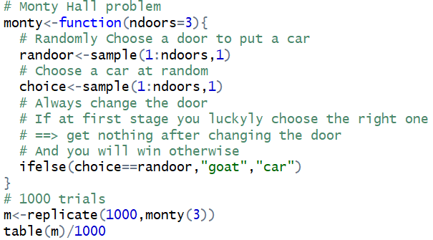


Introduction - The Monty Hall problem
In search of a new car, the player picks a door, say 1. The game host then opens one of the other doors, say 3, to reveal a goat and offers to let the player switch from door 1 to door 2.
Some results of 1000 trials using R

Slide 3
Contents
2.1 Sample Spaces and Events
2.2 Interpretations of Probability
2.3 Addition Rules
2.4 Conditional Probability
2.5 Multiplication and Total Probability Rules
2.6 Independence
2.7 Bayes' Theorem
2.8 Random Variables

Slide 4
Random experiments, Outcomes, Events, and Sample spaces
A experiment that can result in different outcomes, even though it is repeated in the same manner every time, is called a random experiment.
The set of all possible outcomes of a random experiment is called the sample space of the experiment. The sample space is denoted as S.
An event is a subset of the sample space of a random experiment.
Example.
Random experiment: flipping a coin three times (let H represent heads and T represent tails)
The sample space is
S = {HHH, HHT, HTH, THH, HTT, THT, TTH, TTT}
The event of getting at least two heads is
A = {at least two heads} = {HHH, HHT, HTH, THH}

Slide 5
Random experiments, Outcomes, Events, and Sample spaces
A experiment that can result in different outcomes, even though it is repeated in the same manner every time, is called a random experiment.
The set of all possible outcomes of a random experiment is called the sample space of the experiment. The sample space is denoted as S.
An event is a subset of the sample space of a random experiment.
Notation
S = sample space
∅ = empty event

Slide 6
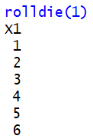

Probability
Used to represent risk or uncertainty in engineering applications
Can be interpreted as our degree of belief
If a sample space consists of N possible outcomes that are equally likely, the probability of each outcome is 1/N.
1/2
1/6
equally likely

Slide 7
Probability - Ex
For a discrete sample space, the probability of an event E, denoted as P(E), equals the sum of the probabilities of the outcomes in E.
Ex. Given
Outcome | a b c d
---------------------------------------------------
Probability | 0.1 0.3 0.5 0.1
Consider the events:
A = {a, b}, B= {b, c, d}, C = {d}
a/ Find P(A), P(B), P(C)
b/ Find P(A′), P(B′), P(A∩C′)
E
E′
Notation
P(E): probability of event E
E′ : complement of event E

Slide 8
Probability - Ex
Ex. A young family plans to have two children. What is the probability of two girls?
Solution 1 (wrong). There are 3 possible families with 2 children: two girls, two boys, and one of each gender. Therefore, the probability of two girls is 1/3.
S = {GG, BG, BB} (NOT equally likely)
➔ P(GG) = 1/3 (!)
Solution 2 (right).
S = {GG, BG, GB, BB} (equally likely)
➔ P(GG) = ¼

Slide 9
Axioms of Probability
P(S) = 1
0  P(E)  1
For two events E₁ and E₂ with E₁ ∩ E₂ = ∅
P(E₁ ∪ E₂) = P(E₁) + P(E₂)
S: the sample space, E: any event
in a random experiment

Slide 10
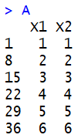
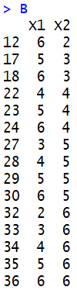

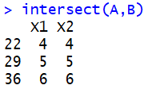

Probability of a Union
P(A ∪ B) = P(A) + P(B) – P(A ∩ B)
If A and B are mutually exclusive events,
P(A ∪ B) = P(A) + P(B)
Ex1. Roll a six-sided die twice.
The sample space is given by
S = {(1, 1), (1, 2), (1, 3), …, (4, 6), (5, 6), (6, 6)}.
Let A = { (X₁, X₂) | X₁ = X₂ } and
B = { (X₁, X₂) | X₁ + X₂ > 7 }.
P(A) = 1/6, P(B) = 15/36, and P(A ∩ B) = 3/36.
What is the probability P(A ∪ B) ?

Slide 11
P(A ∪ B) = P(A) + P(B) – P(A ∩ B)
Ex2. Suppose that after 10 years of service, 40% of computers have problems with motherboards (MB), 30% have problems with hard drives (HD), and 15% have problems with both MB and HD. What is the probability that a 10-year old computer still has fully functioning MB and HD?

Slide 12
Probability of a Union
For three events A, B, C
P(A ∪ B ∪ C) = P(A) + P(B) + P(C)
- P(A ∩ B) - P(A ∩ C) - P(B ∩ C)
+ P(A ∩ B ∩ C)
Ex. If A, B, and C are mutually exclusive events with P(A) = 0.2, P(B) = 0.3, P(C) = 0.4
Determine the probabilities
a/ P(A ∩ B) b/ P(A ∩ B ∩ C)
c/ P(A ∪ B ∪ C) d/ P((A ∪ B) ∩ C)
e/ P(A′ ∩ B′ ∩ C′)
Events E₁, E₂, …, E_{k} is said to be
mutually exclusive if for all pairs,
E_{i} ∩ E_{j} = ∅

Slide 13
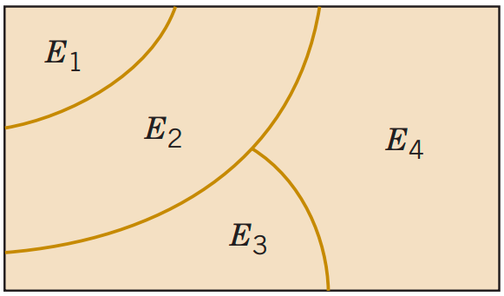
Mutually Exclusive Events
For a collection of mutually exclusive events
P(E₁ ∪ E₁ ∪ … ∪ E_{k} ) = P(E₁) + P(E₂) + … + P(E_{k})
Venn diagram of four mutually exclusive events

Slide 14
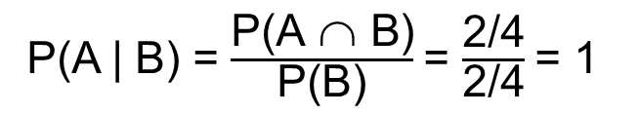

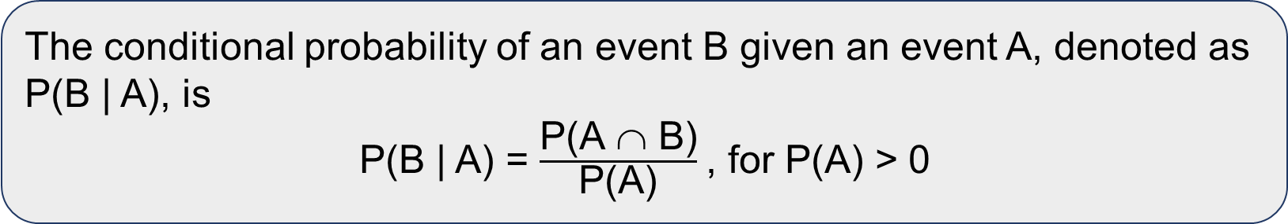
Conditional probability
The conditional probability of an event B given an event A, denoted as P(B | A), is
P(B | A) = $\frac{\text{P}\text{(}\text{A} \text{∩} \text{B}\text{)}}{\text{P}\text{(}\text{A}\text{)}}$, for P(A) > 0
Ex. Toss a coin twice.
The sample space is S = {HH, HT, TH, TT}.
Let A = {at least one head occurs} and
B = {a head and tail occur}.
P(A) = 3/4, P(B) = 2/4, and P(A ∩ B) = 2/4.
What are the probabilities P(A | B) and P(B | A)?
P(A | B) = $\frac{\text{P}\text{(}\text{A} \text{∩} \text{B}\text{)}}{\text{P}\text{(}\text{B}\text{)}}$= $\frac{\text{2/4}}{\text{2/4}}$= 1
P(B | A) = $\frac{\text{P}\text{(}\text{A} \text{∩} \text{B}\text{)}}{\text{P}\text{(}\text{A}\text{)}}$= $\frac{\text{2/4}}{\text{3/4}}$= 2/3

Slide 15
Multiplication Rule
P(A ∩ B) = P(A | B)P(B) = P(B | A)P(A)
P(A₁ ∩ A₂ ∩ A₃) = P(A₂ ∩ A₃ | A₁)P(A₁)
= P(A₁)P(A₂ | A₁)P(A₃ | A₂ ∩ A₁)
Ex. Consider an urn with 10 balls inside, 7 of which are red and 3 of which are green. Select 3 balls successively from the urn. Let A₁ = “1st ball is red”, A₂ = “2nd ball is red”, and A₃ = “3rd ball is red”.
Then P(A₁ ∩ A₂ ∩ A₃) = P(A₁)P(A₂ | A₁)P(A₃ | A₂ ∩ A₁) = (5/8)(6/9)(7/10)

Slide 16
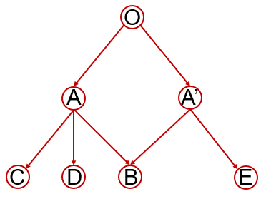
Ex. Someone wants to walk from O to B. What is the probability that he will reach B after two random steps?
P(O → B) = P(O → A → B) + P(O →A’ → B)
= (1/2)(1/3) + (1/2)(1/2) = 1/6 + ¼ = 5/12
½ ½
1/3 1/3 1/3 ½ ½

Slide 17
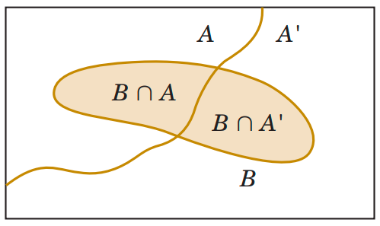
Total Probability Rule (two events)
For any events A and B,
P(B) = P(B ∩ A) + P(B ∩ A′) = P(B | A)P(A) + P(B | A′)P(A′)
Partitioning an event into two mutually exclusive subsets.

Slide 18
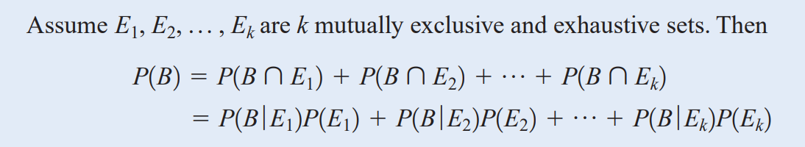
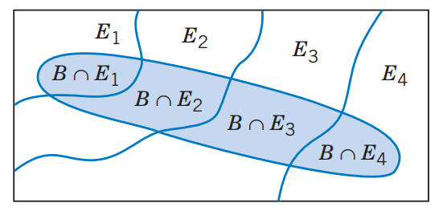
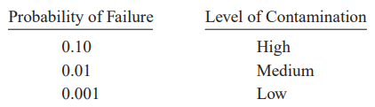
Total Probability Rule (multiple events)
Ex. (Semiconductor Failures) Assume the following probabilities for product failure subject to levels of contamination in manufacturing:
In a particular production run, 20% of the chips
are subjected to high levels of contamination,
30% to medium levels of contamination,
and 50% to low levels of contamination.
What is the probability that a product using one of these chips fails?

Slide 19
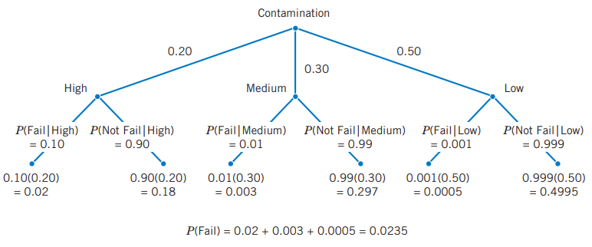
Example (cont.)
Mutually exclusive and exhausted

Slide 20
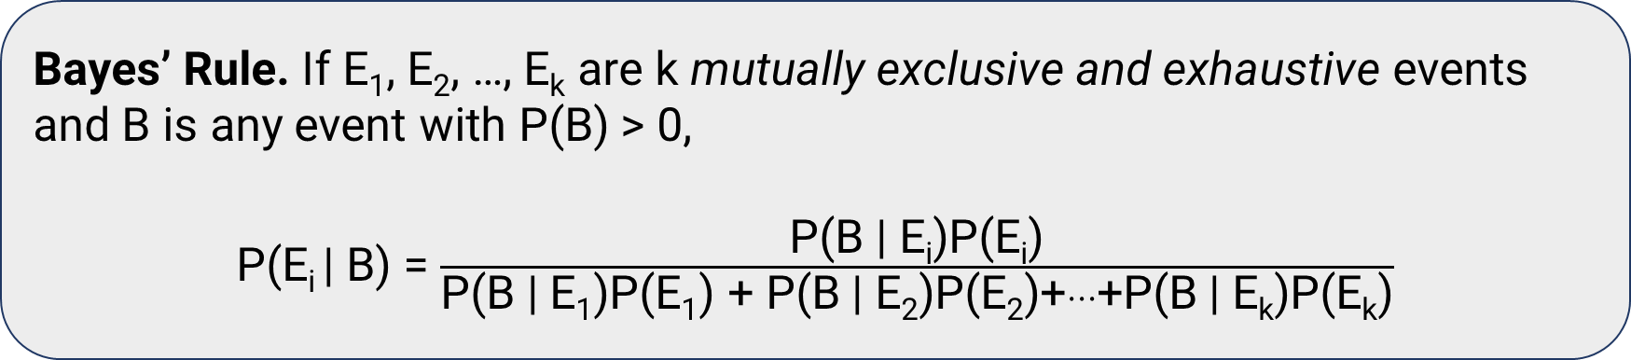
Bayes’ Theorem
Bayes’ Rule. If E₁, E₂, …, E_{k} are k mutually exclusive and exhaustive events and B is any event with P(B) > 0,
P(E_{i} | B) = $\frac{\text{P}\text{(}\text{B}\text{ | }\text{Ei}\text{)}\text{P}\text{(}\text{Ei}\text{)}}{\text{P}\text{(}\text{B}\text{ | }\text{E}\text{1}\text{)}\text{P}\text{(}\text{E}\text{1}\text{) + }\text{P}\text{(}\text{B}\text{ | }\text{E}\text{2}\text{)}\text{P}\text{(}\text{E}\text{2}\text{)+}…\text{+}\text{P}\text{(}\text{B}\text{ | }\text{Ek}\text{)}\text{P}\text{(}\text{Ek}\text{)}}$
Usually in applications we are given (or know) a priori probabilities P(E_{i}). We collect some evidence, which we represent by the event B.
Bayes’ rule can be used to update P(E_{i}) to P(E_{i} | B).

Slide 21
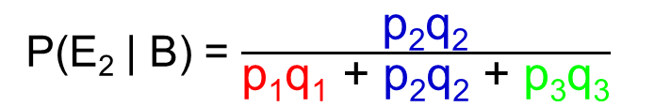
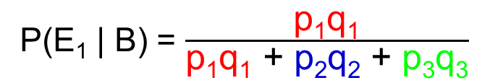

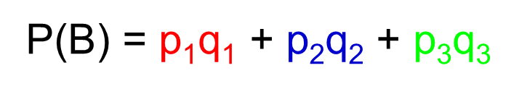
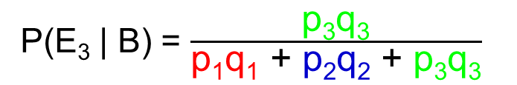
Bayes’ Theorem
mutually exclusive and exhaustive
q₁
P(E₁ | B) = $\frac{\text{p}\text{1}\text{q}\text{1}}{\text{p}\text{1}\text{q}\text{1}\text{ + }\text{p}\text{2}\text{q}\text{2} \text{+ }\text{p}\text{3}\text{q}\text{3}}$
E₁
B | E₁
p₁
p₂
q₂
P(E₂ | B) = $\frac{\text{p}\text{2}\text{q}\text{2}}{\text{p}\text{1}\text{q}\text{1}\text{ + }\text{p}\text{2}\text{q}\text{2} \text{+ }\text{p}\text{3}\text{q}\text{3}}$
E₂
B | E₂
p₃
P(E₃ | B) = $\frac{\text{p}\text{3}\text{q}\text{3}}{\text{p}\text{1}\text{q}\text{1}\text{ + }\text{p}\text{2}\text{q}\text{2} \text{+ }\text{p}\text{3}\text{q}\text{3}}$
q₃
E₃
B | E₃
P(B) = $\text{p}\text{1}\text{q}\text{1}\text{ + }\text{p}\text{2}\text{q}\text{2} \text{+ }\text{p}\text{3}\text{q}\text{3}$
P(E_{i} | B) = $\frac{\text{P}\text{(}\text{B}\text{ | }\text{Ei}\text{)}\text{P}\text{(}\text{Ei}\text{)}}{\text{P}\text{(}\text{B}\text{)}}$

Slide 22
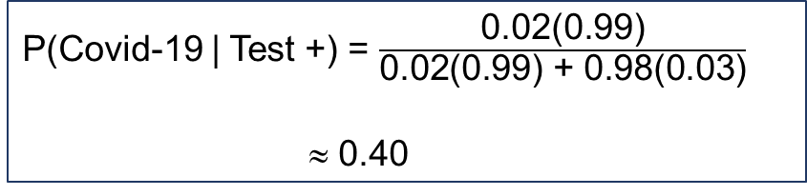
Ex. (Reliability of a Covid-19 Test)
Suppose the probability that a test correctly identifies someone with the Covid-19 as positive is 0.99, and the probability that it correctly identifies someone without the illness as negative is 0.97. The proportion of the Covid-19 in the world is 0.02. A person takes the Covid-19 test, and the result is positive. What is the probability that he/she has the Covid-19, that is, P(Covid-19 | Test +) ?
0.99
Covid-19
Test +
0.02
P(Covid-19 | Test +) = $\frac{\text{0.02(0.99)}}{\text{0.02(0.99) + 0.98(0.03)}}$
≈ 0.40
0.98
0.03
No Covid-19
Test +

Slide 23
Ex - Bayesian Network
Bayesian networks are used on the Web sites of high technology manufacturers to allow customers to quickly diagnose problems with products. An oversimplified example is presented here. A printer manufacturer obtained the following probabilities from a database of test results. Printer failures are associated with three types of problems: hardware, software, and other (such as connectors), with probabilities 0.1, 0.6, and 0.3, respectively. The probability of a printer failure given a hardware problem is 0.9, given a software problem is 0.2, and given any other type of problem is 0.5. If a customer enters the manufacturer’s Web site to diagnose a printer failure, what is the most likely cause of the problem?

Slide 24
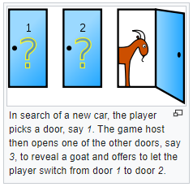
Ex. Monty Hall Problem
(wikipedia.org/wiki/Monty_Hall_problem)
Suppose you're on a game show, and you're given the choice of three doors: Behind one door is a car; behind the others, goats. You pick a door, say No. 1, and the host, who knows what's behind the doors, opens another door, say No. 3, which has a goat. He then says to you, "Do you want to pick door No. 2?" Is it to your advantage to switch your choice?
P(door No. 2 has a car | open door No. 3) = 2/3

Slide 25
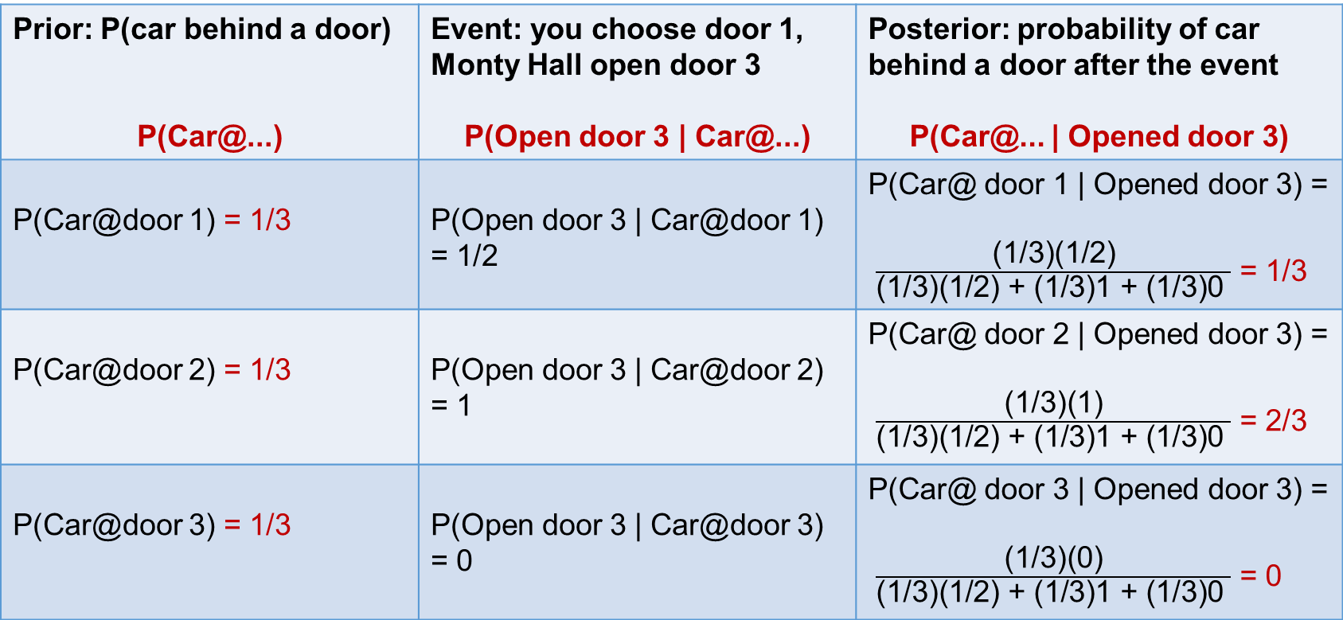
Monty Hall Problem solution
Prior: P(car behind a door) P(Car@...) | Event: you choose door 1, Monty Hall open door 3 P(Open door 3 | Car@...) | Posterior: probability of car behind a door after the event P(Car@... | Opened door 3)
P(Car@door 1) = 1/3 | P(Open door 3 | Car@door 1) = 1/2 | P(Car@ door 1 | Opened door 3) = $\frac{\text{(}\text{1/3)(1/2)}}{\text{(}\text{1/3)(1/2) + (1/3)1 + (1/3)0 }}$ = 1/3
P(Car@door 2) = 1/3 | P(Open door 3 | Car@door 2) = 1 | P(Car@ door 2 | Opened door 3) = $\frac{\text{(}\text{1/3)(1)}}{\text{(}\text{1/3)(1/2) + (1/3)1 + (1/3)0 }}$ = 2/3
P(Car@door 3) = 1/3 | P(Open door 3 | Car@door 3) = 0 | P(Car@ door 3 | Opened door 3) = $\frac{\text{(}\text{1/3)(0)}}{\text{(}\text{1/3)(1/2) + (1/3)1 + (1/3)0 }}$ = 0

Slide 26
Exercise
Given P(B | A) = 0.5, P(A) = 0.3, P(B | A′) = 0.6
a/ Find P(A ∩ B)
b/ Find P(B), P(A ∪ B)
c/ Find P(A | B), P(A’ | B)

Slide 27
Independence (two events)
Two events A, B are independent if any one of the following equivalent statements is true:
(1) P(A | B) = P(A)
(2) P(B | A) = P(B)
(3) P(A ∩ B) = P(A)P(B)
Ex. Toss a fair coin twice.
➔ S = {HH, HT, TH, TT}.
Consider events A = {HT, HH}, B = {HT, TT}, C = {HH}
P(A | B) = ½ = P(A) ➔ A and B are independent
P(C | A) = ½ ≠ ¼ = P(C) ➔ A and C are NOT independent
P(C ∩ B) = 0 ≠ 1/8 = P(C)P(B) ➔ B and C are NOT independent

Slide 28
Independence - Ex1
A computer program is tested by 3 independent tests. When there is an error, these tests will discover it with probabilities 0.2, 0.3, and 0.5, respectively. Suppose that the program contains an error. What is the probability that it will be found by at least one test?
P(at least one test will discover the error) = 1 – P(no test can discover the error)
= 1 – P(1st test will not discover the error)P(2nd test will not discover the error)P(3rd test will not discover the error) = 1 – (0.8)(0.7)(0.5)

Slide 29

Independence – Ex2
Ex. (Series Circuit) The following circuit operates only if there is a path of functional devices from left to right. The probability that each device functions is shown on the graph. Assume that devices fail independently. What is the probability that the circuit operates?
P(the circuit operates) = P(both devices operate)
= P(the left device operates) P(the right device operates) = 0.8(0.9) = 0.72

Slide 30
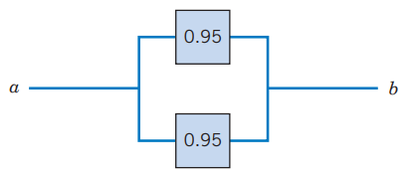
Independence – Ex3
(Parallel Circuit) The following circuit operates only if there is a path of functional devices from left to right. The probability that each device functions is shown on the graph. Assume that devices fail independently. What is the probability that the circuit operates?
P(the circuit operates) = 1 – P(both devices fail) = 1 – P(the top device fails)P(the bottom device fails) = 1 – 0.05(0.05) = 0.9975

Slide 31
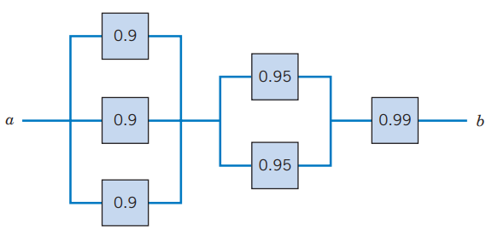
Independence – Ex4
(Advanced Circuit) The following circuit operates only if there is a path of functional devices from left to right. The probability that each device functions is shown on the graph. Assume that devices fail independently. What is the probability that the circuit operates?
P(M) = 1 – (0.95)²
P(R) = 0.99
P(L) = 1 – (0.9)³
Result = P(L ∩ M ∩ R)
= (1 – 0.9³)(1 – 0.95²)(0.99)
= 0.9875

Slide 32
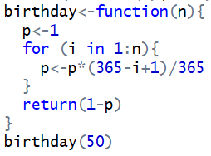



Ex5 – Birthday Problem
Suppose that there are n = 50 people together in a room. Each person announces the date of his/her birthday in turn. What is the probability of at least one match?
Assume all the years have 365 days for simplicity.
P(at least one match) = 1 – P(no match)
= 1 – $\frac{\text{36}\text{4}}{\text{365}}\frac{\text{36}\text{3}}{\text{365}}$ ⋅⋅⋅ $\frac{\text{3}\text{16}}{\text{365}}$ = 0.97 = 97%
Notes:
Simulation in R:
table(replicate(1000,2 %in% table(sample(1:365,50,replace=T))))

Slide 33
Random Variables
A random variable is a function that assigns a real number to each outcome in the sample space of a random experiment.
X : S → 
X(ω) ∈ 
Based on the range of X, we have two types
Discrete random variables: random variables with a finite (or countably infinite) range. X(S) is a finite set {x₁, x₂, …, x_{k}} or countably infinite set {x₁, x₂, …}.
Continuous random variable: random variables with an interval (either finite or infinite) of real numbers for its range (electrical current, length, pressure, temperature, time, voltage, weight, etc.)

Slide 34
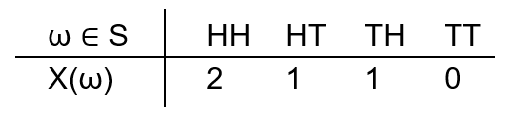
Random variables – Ex1
Flipping a coin twice.
The sample space is S = {HH, HT, TH, TT}.
X : S → 
X(ω) = number of heads in each outcome ω
Discrete random variable

Slide 35
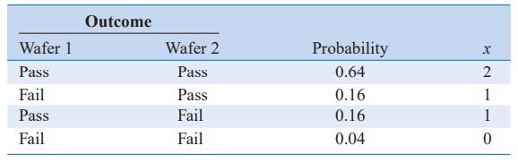
Discrete Random Variables – Ex2
Ex. In a semiconductor manufacturing process, two wafers from a lot are tested. Each wafer is classified as pass or fail. Assume that the probability that a wafer passes the test is 0.8 and that wafers are independent.
S = {pp, fp, pf, ff}
X : S → 
X(ω) = x = number of wafers that pass in ω∈ S
X(S) = {0, 1, 2}
X is discrete RV

Slide 36
Discrete Random Variables - Ex2
Flip a fair coin until it shows a head. Let X be the number of flips in the experiment.
Then the sample space is
S = {H, TH, TTH, TTTH, …}
The range of the random variable is {1, 2, 3, …}
X(H) = 1, X(TH) = 2, X(TTH) = 3, X(TTTTTH) = 6, …
Outcomes
NOT equally likely!
Question: P(X = 6) = ?

Slide 37
Summary
2.1 Sample Spaces and Events
2.2 Interpretations of Probability
2.3 Addition Rules
2.4 Conditional Probability
2.5 Multiplication and Total Probability Rules
2.6 Independence
2.7 Bayes' Theorem
2.8 Random Variables

Slide 38
x = No
(19x + 39) mod 139
(27x + 57) mod 139
(33x + 53) mod 139

